Slide 1
Food Delivery Analysis

Slide 2
Project analysis slide 2
Group Members
Name | CMS
Umar Tariq | 368170
Rohail Zulfiqar | 397977

Slide 3
Project analysis slide 2
INTRODUCTION
With the increasing reliance on delivery services, there's a growing need for optimizing operations to meet rising customer expectations.
By harnessing the power of Big Data Analytics, we aim to transform raw data into actionable intelligence, ultimately improving delivery efficiency and customer satisfaction.
ANALYSIS
IMPLEMENT

Slide 4
Project analysis slide 4
Dataset Features
Features like:
Delivery_person_Age
Delivery_person_Ratings
Weatherconditions
Road_traffic_density
Vehicle_condition
Type_of_vehicle
Festival
Dimensions: (45594 x 19)
Restaurant_coordinates
Destination_coordinates
City
Delivery_time

Slide 5





Project analysis slide 6
Tools and
Technologies

Slide 6


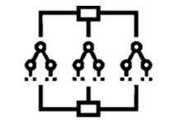
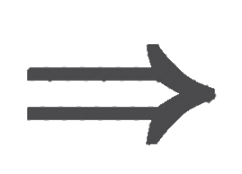
Project analysis slide 3
Steps Followed
EXPLORATORY DATA
ANALYSIS
DATA CLEANING AND PERPROCESSING
FP-GROWTH USING SPARK
RANDOM FOREST REGRESSION USING SPARK

Slide 7
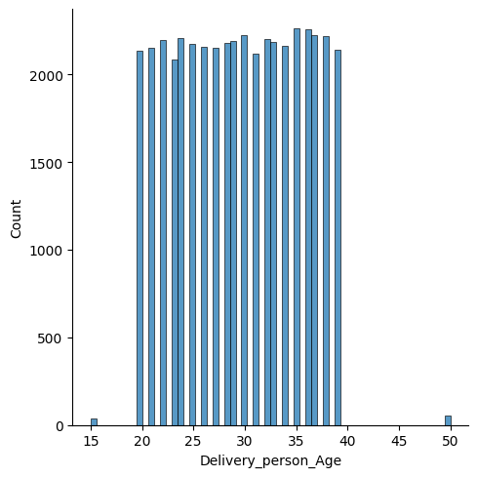
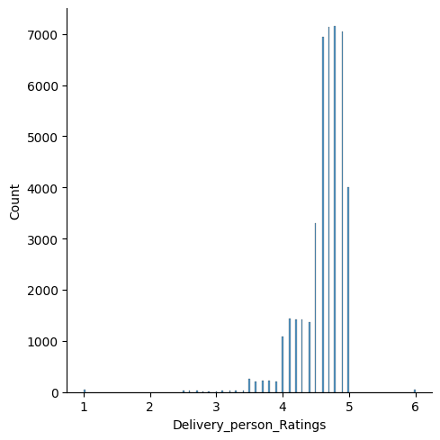
Project analysis slide 4
Exploratory Data
Analysis

Slide 8
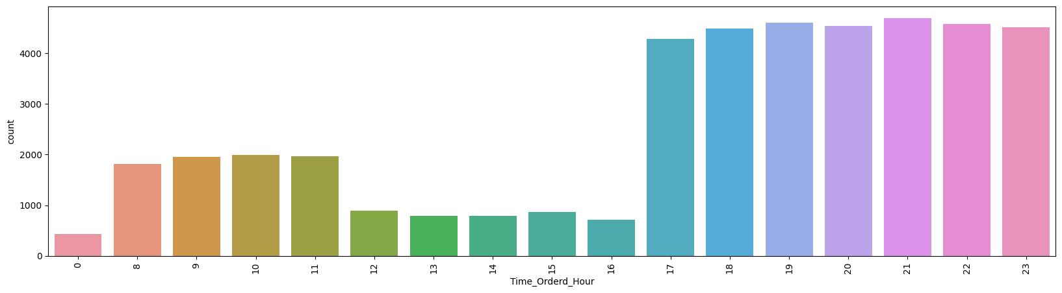
Project analysis slide 4
Continued…

Slide 9
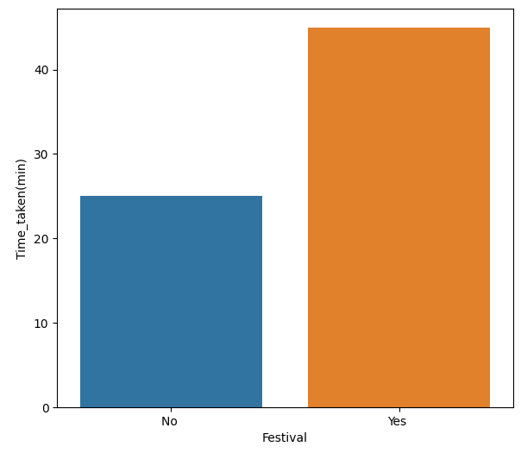
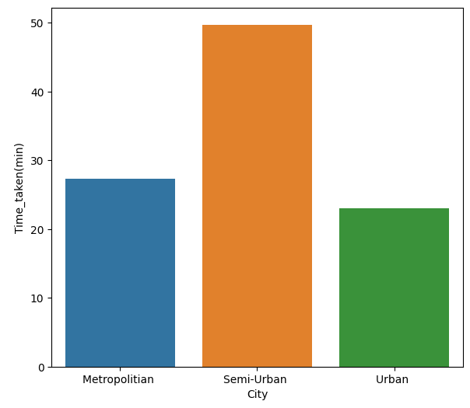
Project analysis slide 4
Continued…

Slide 10
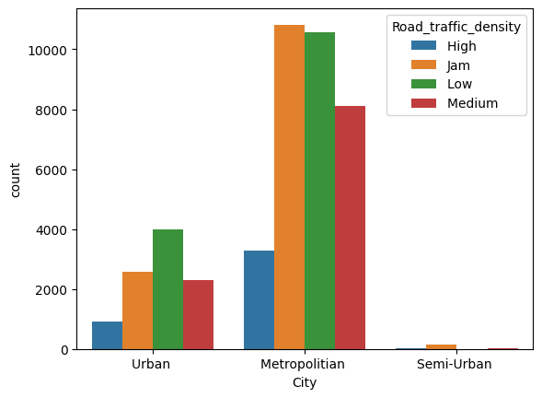
Project analysis slide 4
Continued…

Slide 11
Project analysis slide 4
Data Cleaning
and Preprocessing
Steps involved:
Detected Null and empty entries in the dataset
Replaced with Mean of the corresponding column
Calculated displacement between Source and Destination coordinates using GeoPy
Converted numerical columns to categorical columns for FP-Growth

Slide 12
Project analysis slide 4
FP-Growth
Frequent Pattern Mining:
The FPGrowth algorithm from PySpark's MLlib is utilized to find frequent itemsets and association rules.
Minimum support and confidence thresholds are set to 0.17 and 0.7, respectively, ensuring that only significant patterns are considered.
Association Rules Extraction:
Association rules are generated to find relationships between items in the transactions.
Rules are specifically filtered to find those where "Slow delivery" is a consequent, identifying factors that might lead to slow delivery.

Slide 13
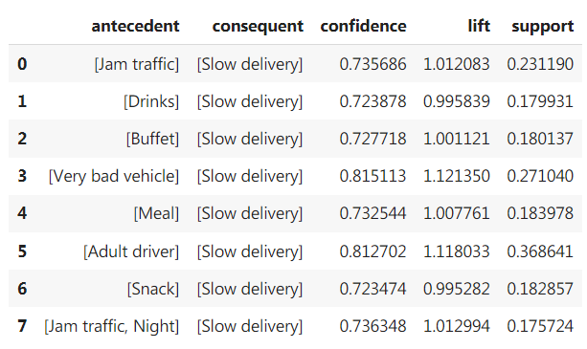
Project analysis slide 4
Results

Slide 14
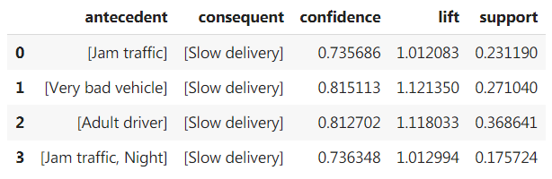
Project analysis slide 4
Continued…
Filtering based on lift:
By setting a threshold (e.g., lift > 1.01), you enhance the quality of your insights by concentrating on rules that have a significant impact.
This helps in identifying more relevant patterns and making better data-driven decisions.

Slide 15
Project analysis slide 4
Random Forest
Regression
Categorical Feature Encoding:
Converting categorical columns into numeric indices using StringIndexer.
Encoding indexed categorical columns into one-hot encoded vectors using OneHotEncoder.
Feature Assembly:
Combining all features (both numerical and encoded categorical) into a single feature vector using VectorAssembler.
Feature Assembly:
Combining all features (both numerical and encoded categorical) into a single feature vector using VectorAssembler.

Slide 16
Project analysis slide 4
Continued…
Model Training:
Training a RandomForestRegressor model with the specified hyperparameters.
Pipeline Construction:
Created a Pipeline that chains all the stages together for seamless execution.
Model Evaluation:
Splitting the data into training and testing sets.
Fitting the pipeline on the training data.
Making predictions on the test data.
Evaluating the model's performance using metrics like R-squared (R2), Mean Absolute Error (MAE), Mean Squared Error (MSE), and Root Mean Squared Error (RMSE).

Slide 17
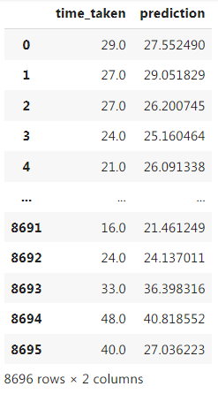
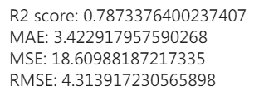
Project analysis slide 4
Results

Slide 18
Thank You

